Slide 1
SharePoint Add-Ins
Deploying Add-Ins

Slide 3
How to View This Presentation
To switch to Notes Page view:
On the ribbon, click the View tab, and then click Notes Page
To navigate through notes, use the Page Up and Page Down keys
Zoom in or zoom out, if required
In the Notes Page view, you can:
Read any supporting text—now or after the delivery
Add notes to your copy of the presentation, if required
Take the presentation files home with you

Slide 4
Overview
Ways to obtain Add-Ins
In this Lesson
How to package and deploy your Add-Ins
What is the App Catalog and how to use it
Available methods for pushing an Add-In

Slide 5
Objectives
Learn how to package and deploy your Add-Ins
Know about the options available for deployment and obtaining Add-Ins

Slide 6
Obtaining Add-Ins
SharePoint Store
Public Store for SharePoint Add-Ins
Similar Windows Phone Marketplace
Subject to submission process & Approval
Can be enabled\disabled via Central Administration
App Catalog
Add-Ins developed within your company
Add-Ins acquired and approved for internal use
Custom Deployment Process
Developers can use SharePoint APIs to deploy Add-Ins with custom code
Allows integration within an automated Team Foundation System build process
Notes:
Customers have multiple ways of obtaining Add-Ins. Developers can create Add-Ins and submit them to a public marketplace. These types of Add-Ins will be validated by Microsoft similar to how Add-Ins for the Windows Phone are validated. Customers can then acquire these Add-Ins and pay for them if they are not free.
Enterprises can also use a corporate catalog which is essentially a private marketplace for their deployment (or tenant in a hosted environment). Enterprise developers can deploy Add-Ins to their corporate catalog in order to distribute Add-Ins to SharePoint sites but not make them publically available.
Finally SharePoint contains APIs allowing developers to do a direct deployment of an Add-In to SharePoint bypassing the marketplace. This is similar to what happens when Add-Ins are developed and tested using F5 debugging in Visual Studio. They can also be utilized to automate the build process using Team Foundation Build services.

Slide 7
Deploying Add-Ins – App Package
SharePoint Add-Ins are deployed using .App packages
Application package is a ZIP archive containing files to be deployed
AppManifest.xml file
Other supplemental files as needed
Inner solution package (.wsp)
Inner solution package
Required to deploy site elements to App Web
Contains Web-scoped feature for App Web
Cannot contain DLL or any .NET code
Contains declarative elements only (e.g. Lists, Pages, etc.)
MySharePointApp.app
Appmanifest.xml
MySharePointApp.wsp
manifest.xml
feature.xml
elements.xml
Home.aspx
App.css
App.js
App Custom Actions
App Parts
Notes:
A SharePoint Add-In is packaged up for deployment using a ZIP archive file known as an Application package. Note that the ZIP file for an Application package is created using the same Open Package Convention format that is used for Word documents (docx) and Excel workbooks (xslx).
It is a requirement for the Application package to contain a AppManifest.xml file. This is what SharePoint uses to read the Add-Ins metadata during installation. The Application package can and usually contains other files as needed for the Add-In’s implementation.
Note that the ZIP file for an Application packages must have an file extension of .App. In earlier betas, Application packages were given a file extension of .spApp instead of .App.
It’s important for developers to understand the contents of an Application package file. The most important file that is included is the Application manifest file named AppManifest.xml. The Application package in most cases will also contain an inner solution package. The inner solution package is a CAB file with a .wsp file extension which has the exact same file format as the solution packages you distribute for farm solutions and sandboxed solutions.
The inner solution package is required to deploy site elements to the App web. The inner solution package contains exactly one Web-scoped feature which is what adds declarative elements to the App web when an Add-In is installed. Remember that the inner solution package can contain declarative elements such as lists, pages, CSS files and JavaScript files. However, the inner solution package cannot contain a DLL or any .NET code whatsoever. Therefore, you can say that the inner solution package is constrained to be a fully declarative solution package. This is different than the solution packages for farm solutions and sandboxed solutions which can contains DLL assemblies with code written in either C# or VB.NET.

Slide 8
Deploying Add-Ins – App Catalog
WSP gets activated on the Add-In Web
Custom Actions and App Parts get deployed to the Host Web
AppManifest.xml was already in the App Catalog when you added it to the App Catalog
App Catalog
MySharePointApp.app
Appmanifest.xml
Host Web
MySharePointApp.wsp
manifest.xml
feature.xml
Add-In Web
elements.xml
Home.aspx
App.css
App.js
App Custom Actions
App Parts

Slide 9
Demo: Packaging Add-Ins
Notes:
Show your students how to create and package Add-Ins. You can use the following hidden slides as guidance or in case you can’t or don’t want to do the demo, you can unhide these slides to show the students how it can be done.

Slide 10

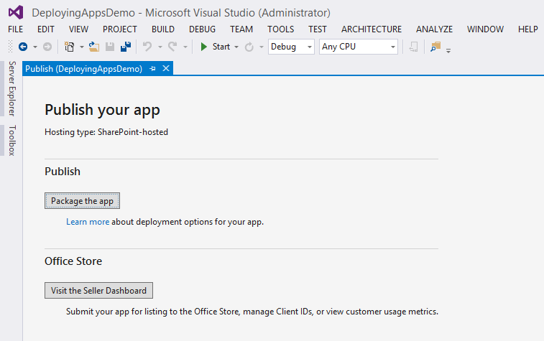
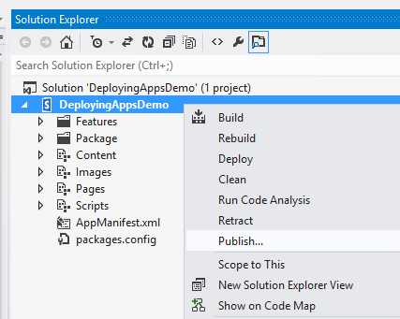
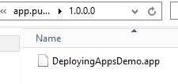
Creating an Add-In Package
SharePoint-hosted
Publishing the Add-In from Visual Studio creates .app file
Notes:
In Visual Studio, right click on the Add-In project, click on Publish. On the Publish your app page, click on Package the app. This will generate an App package, open up a file explorer and show the file. Notice how the folder structure contains the Add-In version number. This prevents issues like often seen before with Full Trust Code Apps generated by Visual Studio where something would still have a file lock on the WSP file (i.e. the virus scanner) when Visual Studio would create a new WSP package thus the packaging failing or even worse, seemingly succeeding but the old WSP package remaining there. No more of that with Add-Ins.

Slide 11

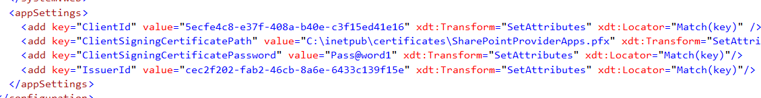
Creating an Add-In Package
Provider-hosted
Utilize the web.<profile>.config files to configure the High Trust environment variables for each environment
Not necessary when using WebDeploy (discussed later on)
Notes:
Visual Studio offers an option to create different version of the web.config file for each solution configuration. You can utilize this to provide different settings like the SharePoint Oauth Add-In Settings for different staging environments.

Slide 12
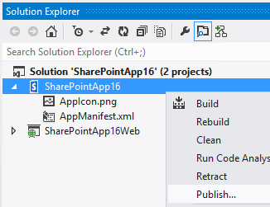
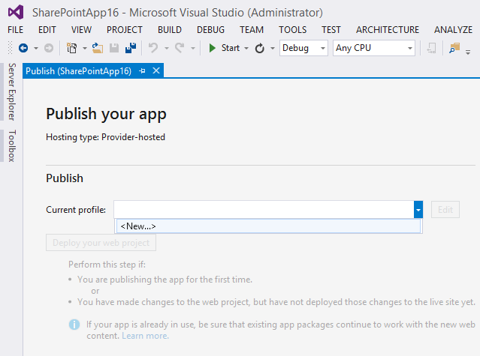
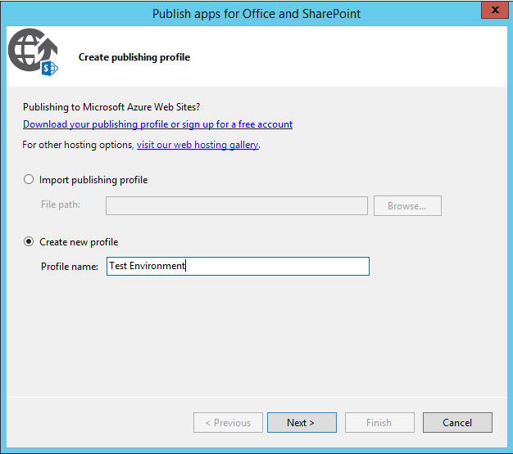
Creating an Add-In Package
Package the remote web application
Provider-hosted Add-Ins
Notes:
Go through the process in Visual Studio to create a publishing profile as shown on this slide

Slide 13
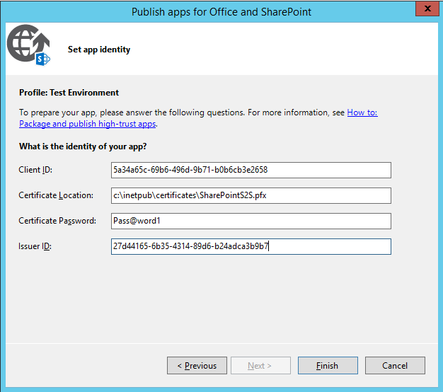
Creating an Add-In Package
Provider-hosted
Define the environment specifics
Allows providing the variables for the specific environment to deploy to
In the OAuth chapter we’ll dive deeper into what these mean and how to get them
Notes:
Fill in the details to be used for the OAuth trust on the environment you’re deploying to

Slide 14
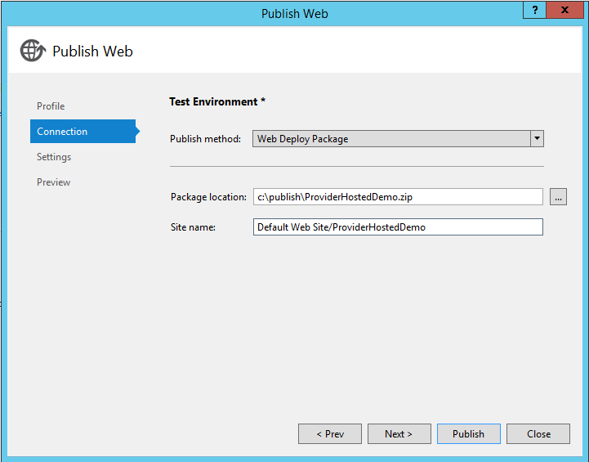
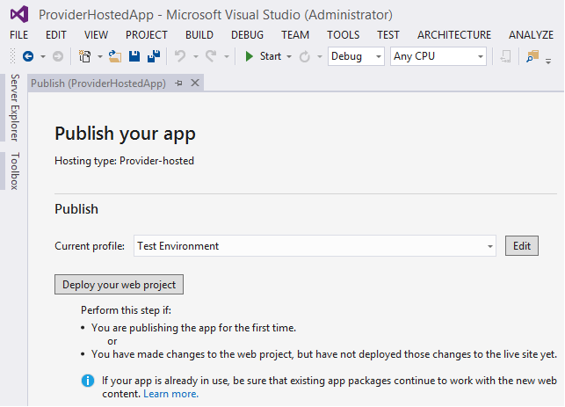
Creating an Add-In Package
Provider-hosted
Specify the connection variables
Notes:
In Visual Studio, right click on your web project and click on Publish. This takes you to the Publish your Add-In page where you can choose to deploy your web project.

Slide 15
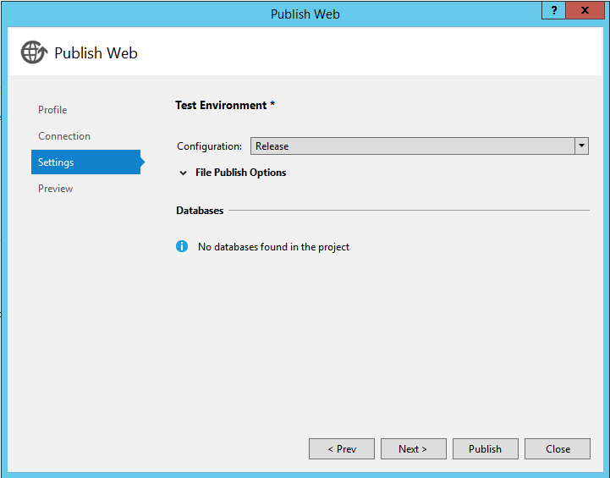
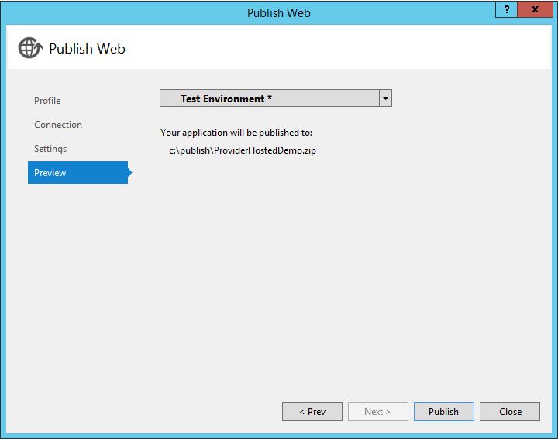
Creating an Add-In Package
Provider-hosted
Specify Configuration Settings

Slide 16
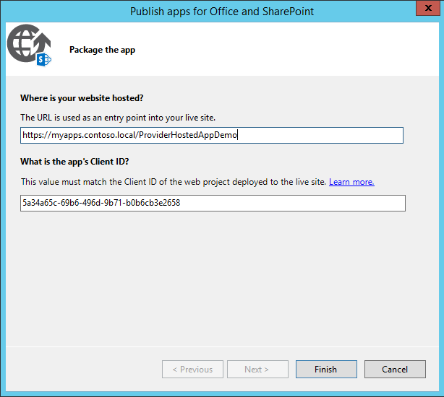
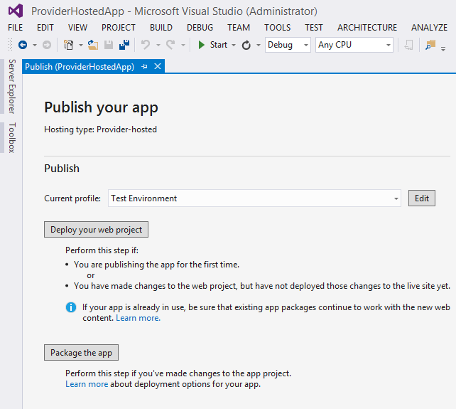
Creating an Add-In Package
Provider-hosted
Package the SharePoint Add-In

Slide 17
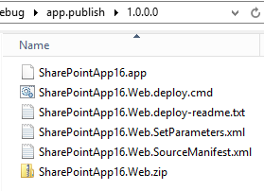
Creating an Add-In Package
Provider-hosted
Output is the .app package and a set of files to deploy the Web Application to the target host
WebDeploy package is also created automatically

Slide 18
Creating an Add-In Package
Provider-hosted
WebDeploy allows you to install your Add-In on an IIS machine and automatically configure it correctly
Components
<projectname>.deploy.cmd Deployment script
<projectname>.deploy-readme.txt Explains how to use WebDeploy
<projectname>.SetParameters.xml IIS configuration to apply
<projectname>.SourceManifest.xml Which files to include in the deploy
<projectname>.zip The files of which your Add-In consists
Notes:
For more information regarding WebDeploy, see: http://technet.microsoft.com/en-us/library/dd569024%28v=ws.10%29.aspx

Slide 19
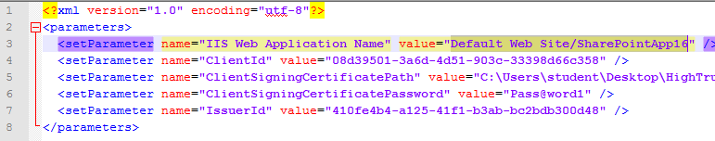
Creating an Add-In Package
Provider-hosted
Make sure to edit the <projectname>.SetParameters.xml and set the right name of the IIS WebApplication to deploy it to
Other values are already retrieved from the Wizard

Slide 20
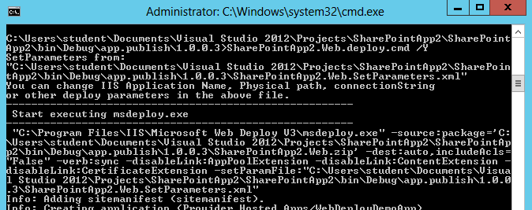
Creating an Add-In Package
Provider-hosted
Execute the script with the .cmd file providing the /Y argument

Slide 21
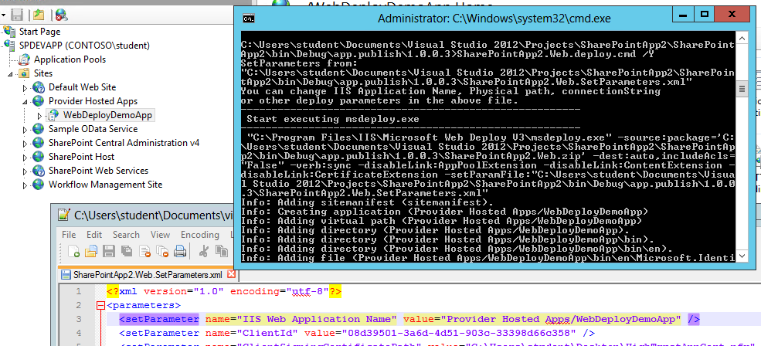
Creating an Add-In Package
Provider-hosted
Result: new IIS Application, authentication configured, web.config AppSettings set to the proper values

Slide 22
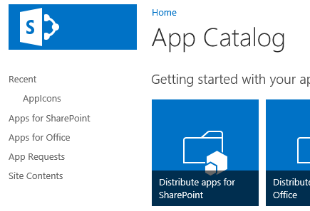
App Catalog
App Catalog is just another site collection with a site definition (APPCATALOG#0)
Therefore this may be created as a Host Named Site Collection
Add-Ins will be deployed to the App Catalog
Each Web Application can have its own App Catalog
Site Collection Scoped App Catalog is also possible
Only in SharePoint Online
Notes:
The Add-In Catalog is just yet another site collection using the AppCatalog#0 template. Knowing this, we have all the functionality available that we have on any site collection. Like creating additional libraries or fields. Where you publish your Add-Ins in are normal document libraries.
In SharePoint Online the ability to have an App Catalog per site collection is also possible. It allows both Add-Ins (.app) as well as SharePoint Framework packages (.sppkg) files to be deployed only to specific site collections. So if you build a customization target for i.e. the HR department only, you can ensure this functionality only surfaces on the HR site collection and nowhere else within the same SharePoint web application/farm/tenant. More information: https://youtu.be/7ZdqLG03PwU?t=1516 and https://dev.office.com/blogs/announcing-new-development-and-management-tools-for-sharepoint-framework

Slide 23
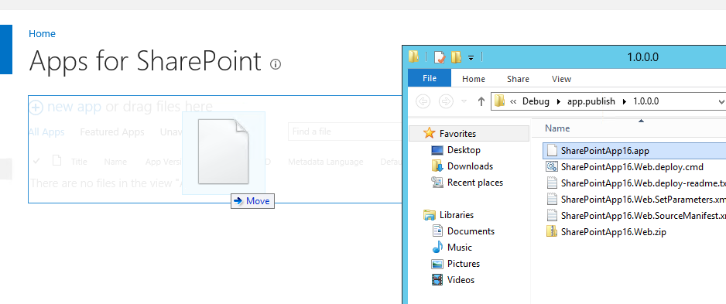
App Catalog
Deploying an app to your organization:
Go to the App Catalog site
Click on the Apps for SharePoint link on the left
Drag and drop the .app package in the document library
Notes:
To deploy an Add-In, have Visual Studio generate an Add-In package. Once its done with that it will show a file explorer where the Add-In package was generated. Now browse to the Add-In Catalog its Apps for SharePoint library. You can simply drag and drop the .app file into it to add it to the Add-In Catalog.

Slide 24
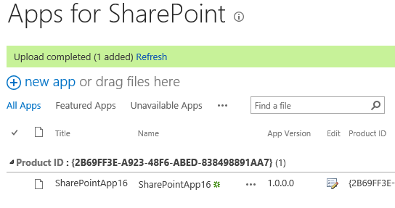
App Catalog
The metadata will be extracted from the .app package
Notes:
After dropping your .app file into the document library, SharePoint will extract its contents using an event receiver which executes the code in Microsoft.SharePoint.Marketplace.CorporateCuratedGallery.SPCorporateCatalogEventReceiver located in the Microsoft.SharePoint.dll and gets the metadata out of it so it can add it to the list item its properties.
Sometimes dropping the .app file into the document library on the Add-In Catalog can take several minutes to complete. A little trick to speed this up is to drop the file, cancel it and immediately drop it again. Usually it then completes in a matter of seconds.

Slide 25
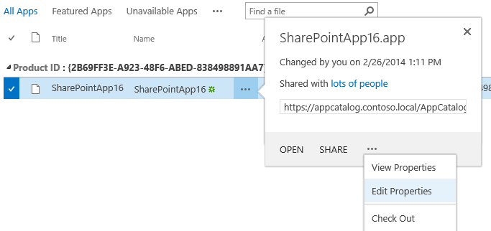
App Catalog
Additional metadata can be provided in the item properties
Notes:
Note that the AppManifest.xml only allows you to specify a limited set of information about your Add-In, like its title and description. There’s however more information that can be provided to end users to take the decision whether or not to install your Add-In to their site. This information can be added to your Add-In only after copying it to the Add-In Catalog and by clicking on the pencil icon or alternatively on the ellipsis followed by clicking on the ellipsis in the popout window followed by clicking on Edit Properties.

Slide 26
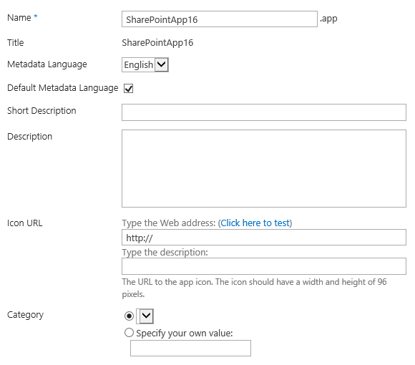
App Catalog
In the .app properties you can configure
Short description (displayed in the Add-In popup)
Long description (displayed in about and installing Add-In)
Icon url (shown before installing the Add-In)
Publisher information
Screenshots
Featured Add-In
If the Add-In is available at the moment
Notes:
In the properties of the Add-In, for example, you can set the Icon of the Add-In that will be shown when browsing through the Add-Ins an user can add. The Add-In Icon defined in the AppManifest.xml inside the .app package is ONLY shown AFTER having added the Add-In to a site.

Slide 27
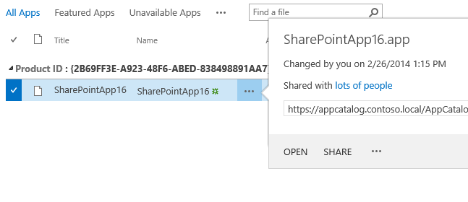
App Catalog
Use item level permissions to define who can see and add the Add-In
Notes:
You can restrict who can see (and thus add) your Add-In by setting the list item properties of the .app in the Apps for SharePoint document library. A user needs at least read rights to the list item to be able to add it to the sites of which they’re a site owner.

Slide 28
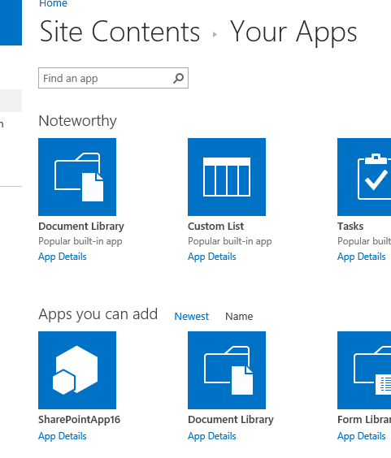
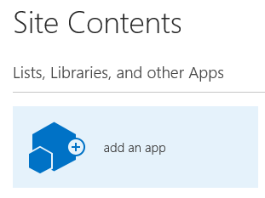
App Catalog
You should now be able to see the Add-In when going to Site Contents and clicking “add an app”
Notes:
On any site you can now go to the Site Contents and click on “add an app”. Alternatively you can click on the gear icon at the top left and click on “Add an app”. You should now be able to see your Add-In from the Add-In Catalog and add it to the site.

Slide 29
Knowledge Check
In the .app properties what can you configure?
Short description (displayed in the Add-In popup)
Long description (displayed in about and installing Add-In)
Icon url (shown before installing the Add-In)
Publisher information
Featured Add-In
Where is metadata extracted from?
.app package
Manifest file
Onet.xml
Webtemp*

Slide 30
Knowledge Check
In the .app properties what can you configure?
Short description (displayed in the Add-In popup)
Long description (displayed in about and installing Add-In)
Icon url (shown before installing the Add-In)
Publisher information
Featured Add-In
Where is metadata extracted from?
.app package
Manifest file
Onet.xml
Webtemp*

Slide 31
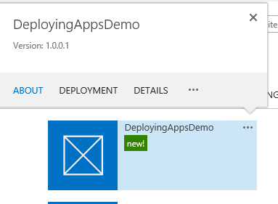
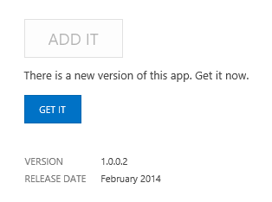
Add-In Updates
Raise the version in the AppManifest
Compile a new .app package
Upload it over the existing .app package in the App Catalog
Update visible when going to About
Notes:
The procedure of updating an Add-In is simply dropping your new version of your Add-In into the Add-In Catalog. Be sure to raise the version of the Add-In yourself in Visual Studio in the app manifest as it will not happen automatically. There’s no specific requirement on how your version should increment, as long as it’s higher than the previous version, it is fine.
The way to directly apply the update your Add-In to an already installed and deployed instance of the Add-In is to go to Site Contents where the Add-In is deployed, click on the ellipsis, then on About and then click on Get It.

Slide 32
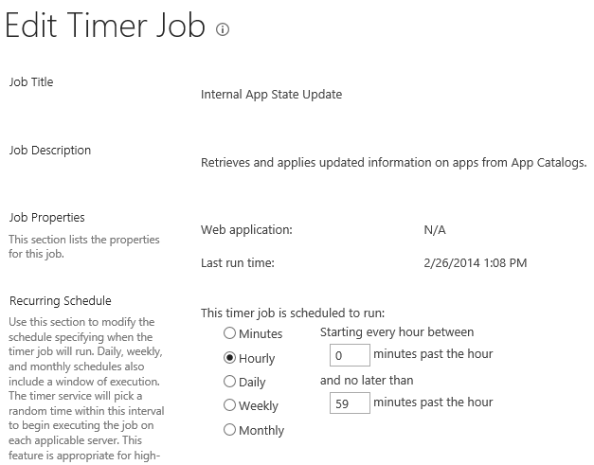
Add-In Updates
A timer job named “Internal App State Updates” checks for new Add-In versions in the Add-In Catalog once every hour
The actual check is overridden by a property which by default only allows checking once every 24 hours. Change it using: Set-SPInternalAppStateUpdateInterval -AppStateSyncHours n n = 0 means always perform check when TimerJob runs
Notes:
A Timer job named Internal App State Updates is responsible for checking for updated versions of installed Add-Ins in the Add-In Catalog. It runs once an hour by default. Running it doesn’t mean it will do its detection task. The code behind the timerjob located in the class Microsoft.SharePoint.Administration.SPInternalAppStateQueryJobDefinition of the Microsoft.SharePoint.dll defines that by default only once in 24 hours it will actually perform its task, even though the timerjob is set to run hourly. This behavior can be changed using PowerShell by running Set-SPInternalAppStateUpdateInterval. When setting AppStateSyncHours to 0, it means every time the timerjob runs, it will check for updated versions.

Slide 33
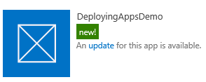
Add-In Updates
After the Timer Job has run, it will show a notification next to Add-Ins for which an update is available
Add-Ins will not be upgraded to the new version unless the site owner takes action
Notes:
When the timerjob has ran and it didn’t get blocked by the setting how often to actually check for new versions, it will display an Update notification next to the Add-Ins that have a newer version present in the Add-In Catalog. It will NOT apply the update to all installed Add-In instances automatically. The site owner is still in charge here. He/she defines which Add-Ins to install and which Add-Ins to update.

Slide 34

Add-In Updates
After an Add-In update has been initiated, a backup will be made of the AppWeb subsite
The backup is used to create a copy of the AppWeb
The update is applied to the AppWeb copy
If the update succeeds, the AppWeb copy is discarded and the update is applied on the original AppWeb
The AppUpgraded event is triggered which allows you to perform custom actions via CSOM
Notes:
For more information, see: https://docs.microsoft.com/en-us/sharepoint/dev/sp-add-ins/sharepoint-add-ins-update-process

Slide 35
Pushing Add-Ins (UI)
Add-Ins can also be pushed to sites
Comparable to feature stapling, but now known as App/Add-In Stapling
Will be applied to existing sites and sites that will be created after configuring this
Important differences
All sites share the same Add-In instance
Updating the shared instance, updates it everywhere it has been pushed
This is not possible for Add-Ins containing App Parts or custom actions
App Install, Uninstall and upgrade event receivers cannot be handled
Site Owners of sites to which the Add-In has been pushed will not be able to remove it
Notes:
Add-Ins can also be pushed out to sites. This is known as App/Add-In Stapling. In this scenario an end user doesn’t have to add the Add-In to his/her site him/herself
For more information, see: https://docs.microsoft.com/en-us/sharepoint/dev/sp-add-ins/tenancies-and-deployment-scopes-for-sharepoint-add-ins and http://blogs.msdn.com/b/frank_marasco/archive/2014/07/26/side-loading.aspx

Slide 36
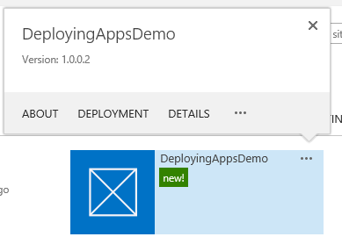
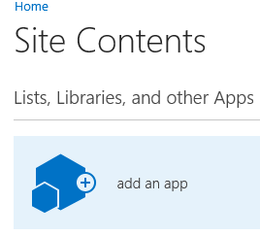
Pushing Add-Ins (UI)
First make the Add-In available through the App Catalog
Add the Add-In to the App Catalog site collection itself through the normal procedure
Notice how the Add-In context menu has an extra option “Deployment”, click on it
Notes:
Add-Ins can be pushed out (App\Add-In Stapling) by adding the Add-In to the Add-In Catalog itself. When doing so, the Add-In context menu will display an extra option called Deployment. Click on it to define the sites where you wish to push the Add-In to.

Slide 37
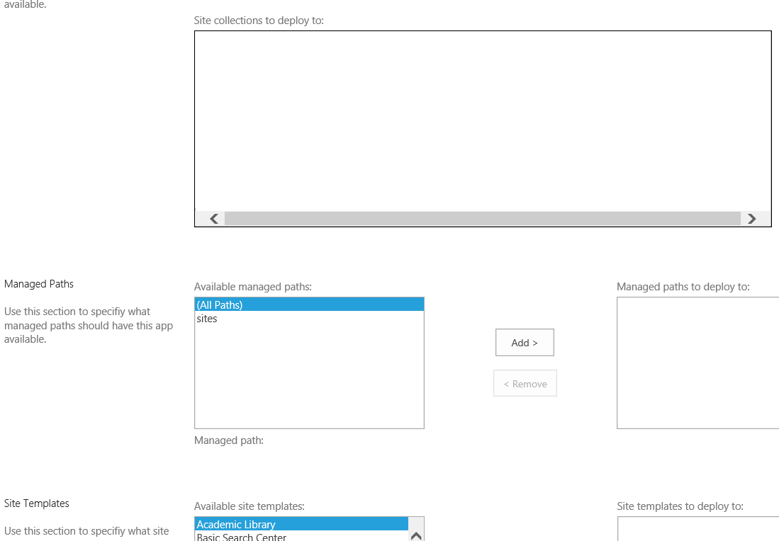
Pushing Add-Ins (UI)
Choose where to push your Add-In:
Absolute url(s) of site collections
Doesn’t allow subsites to be targeted
All sites under designated managed paths
All sites using designated templates
Notes:
Add-Ins can be pushed to the sites you define, to all sites under managed paths you choose or to all sites using a particular site template.
For more information, see: http://www.sharepointnutsandbolts.com/2013/04/rolling-out-sharepoint-2013-apps-to.html

Slide 38
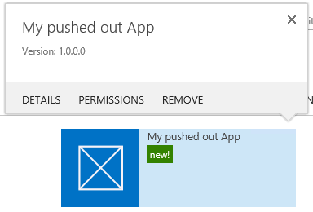
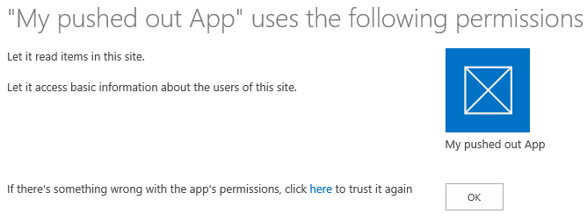
Pushing Add-Ins
Add-Ins that do NOT share the same AppWeb
Only possible through PowerShell
Add-Ins each receive their own AppWeb
Trust will NOT be established automatically
Site Owner needs to “repair rights” in order for the trust to be established for that Add-In Instance (by design)
Notes:
If you don’t want the pushed out Add-Ins to share the same instance thus App Web, you can also push them in a way that they will get their own App Web. This is only possible via PowerShell and does have some consequences as mentioned on this slide.

Slide 39
Pushing Add-Ins
Add-ins that do NOT share the same AppWeb
Get an instance to the Add-In package using: $spapp = Import-SPAppPackage -Path "D:\DeployingAppsDemo.app" ` -Site https://dev.contoso.local ` -Source ObjectModel
Push the Add-In to a subsite using: Install-SPApp -Web https://dev.contoso.local -Identity $spapp
Apps vs. App/Add-In Stapling:
App Install, Uninstall and upgrade event receivers do fire and can be handled
Site Owners can uninstall the application
Custom actions and app parts are supported
Apps can also be pushed to subsites, not just to the site collection root
Notes:
This slide shows the PowerShell commands you can use to push an Add-In to multiple sites while each of them having their own AppWeb.
For more information:
http://blogs.msdn.com/b/frank_marasco/archive/2014/07/26/side-loading.aspx
And:
http://blogs.msdn.com/b/officeapps/archive/2013/12/10/enable-app-sideloading-in-your-non-developer-site-collection.aspx

Slide 40
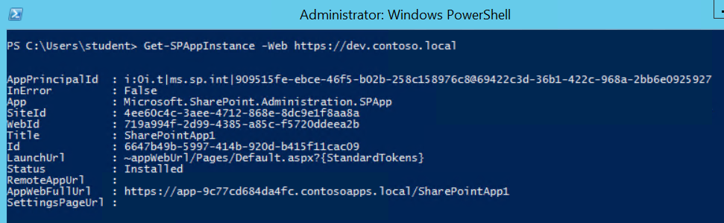
Add-In Catalog
Validate if an Add-In installed successfully
Use PowerShell to get an overview of all installed Add-Ins Get-SPAppInstance -Web https://dev.contoso.local
Notes:
If you want to verify if the Add-In deployed successfully, you can execute the PowerShell command as shown on the screen.

Slide 41
Knowledge Check
What are your two main sources for obtaining SharePoint Add-Ins?
After deploying a new version of your SharePoint Add-In, how can you directly update an existing instance?
SharePoint Store
What is App\Add-In Stapling, how does it work and what are its characteristics?
By going to the installed instance of the Add-In, clicking on the ellipsis, going to About you will see the update and it will allow you to update.
Pushing out Add-Ins to specific sites
Corporate App Catalog
Can be done in the App Catalog site collection
Allows pushing Add-Ins to specific urls, sites of specific templates or sites under specific managed paths
All sites will share the same Add-In Instance (thus AppWeb)

Slide 42
Lesson Summary
Add-Ins can be obtained from the SharePoint Store or corporate App Catalog
Visual Studio can be used to package Add-Ins
Add-Ins can be added by site owners or pushed by admins

Slide 43
Questions?

Slide 44
Lab: Provider hosted Add-Ins
In this lab you will set up a high trust between your SharePoint environment and an application running on Internet Information Services. The application will retrieve and display the lists hosted on the Host Web.
Time estimation: 60 minutes
Notes:
Lab content can be found under “Lab - Provider Hosted Addins”

